Slide 1

Comparison of Temporal Graph Neural Network Traffic Forecasting Models
EECS 298 Network Science
Eric Le, Jason Wu, John Liu
Professor Yanning Shen
3/10/2022

Slide 2
Presentation Overview
1) Motivation
2) Temporal Graph Neural Networks
3) Problem
4) Previous Works
5) Traffic Forecasting Model Summaries
6) Comparison Between Models
7) Future Direction
8) References

Slide 3
Motivation
Traffic congestion occurs everyday in large cities such as Los Angeles, especially during on-off work hours, weekends, or holidays
Consequences of traffic congestion are wasted fuel and pollution
Intelligent and autonomous transportation systems, better transportation management and efficient traffic control all address these problems
Implementation of such systems however, rely on the ability to forecast traffic

Slide 4
Temporal Graph Neural Networks
Traffic forecasting can be accomplished with machine learning applications through Temporal Graph Neural Networks (TGNN)
TGNNs can handle both spatial information of graphs as well as accounts for how node features change over time.
TGNNs evolve very naturally in many areas such as social networks, pandemics, or traffic systems.

Slide 5
Problem
There exist many TGNN models that can be used in the application of traffic forecasting
Each model differs widely on how they would handle the spatial and temporal aspects of a traffic network
We set out to compare some of the more prominent models to find out which offers the most consistent traffic speed predictions in large cities like LA.

Slide 6
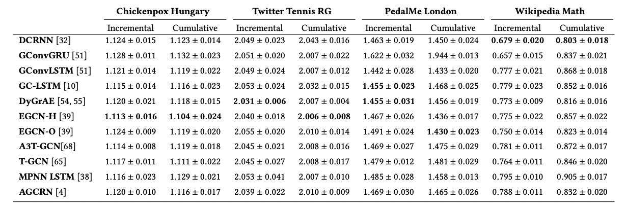
Previous Works
A comparison of prominent recurrent TGNN models has been made in other forecasting context

Slide 7
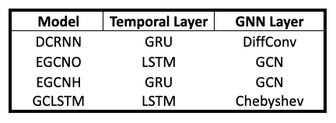
Traffic Forecasting TGNN Models
We chose the models that were most consistent in predictions across other forecasting context, while also providing a spectrum of different spatial and temporal layers utilized.
1. Diffusion Convolutional Recurrent Neural Network (DCRNN)
2. Evolve Graph Convolutional Network (EGCN)
EGCN-H
EGCN-O
3. Graph Convolutional Long Short Term Memory (GCLSTM)

Slide 8
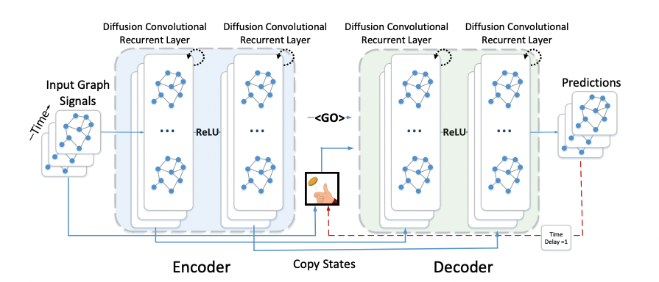
DCRNN Model
To capture spatial dependencies, it utilizes bidirectional random walks on graphs and diffusion convolution to build a Diffusion Convolutional Layer
To capture temporal dependencies, it uses an encoder-decoder with scheduled sampling
Historical traffic data is fed into an encoder whose final states are used to initialize the decoder. Then, the decoder makes the predictions based on the previous ground truth or the model output.

Slide 9
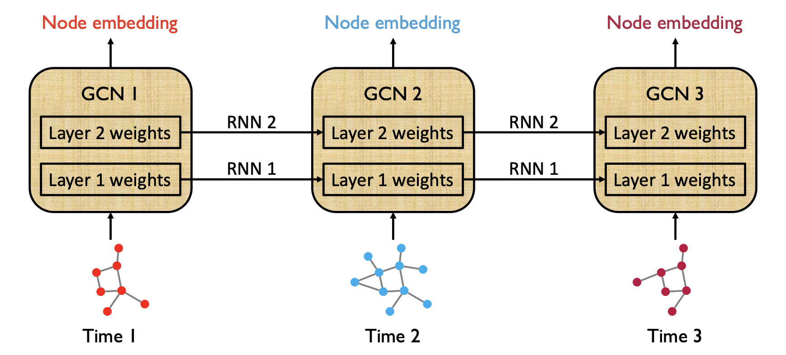
EGCN Models
Utilizes a Graph Convolutional Network (GCN) for spatial dependencies and a two different recurrent architectures for temporal dependencies
Adapts the GCN along temporal dimensions without resorting to node embeddings

Slide 10
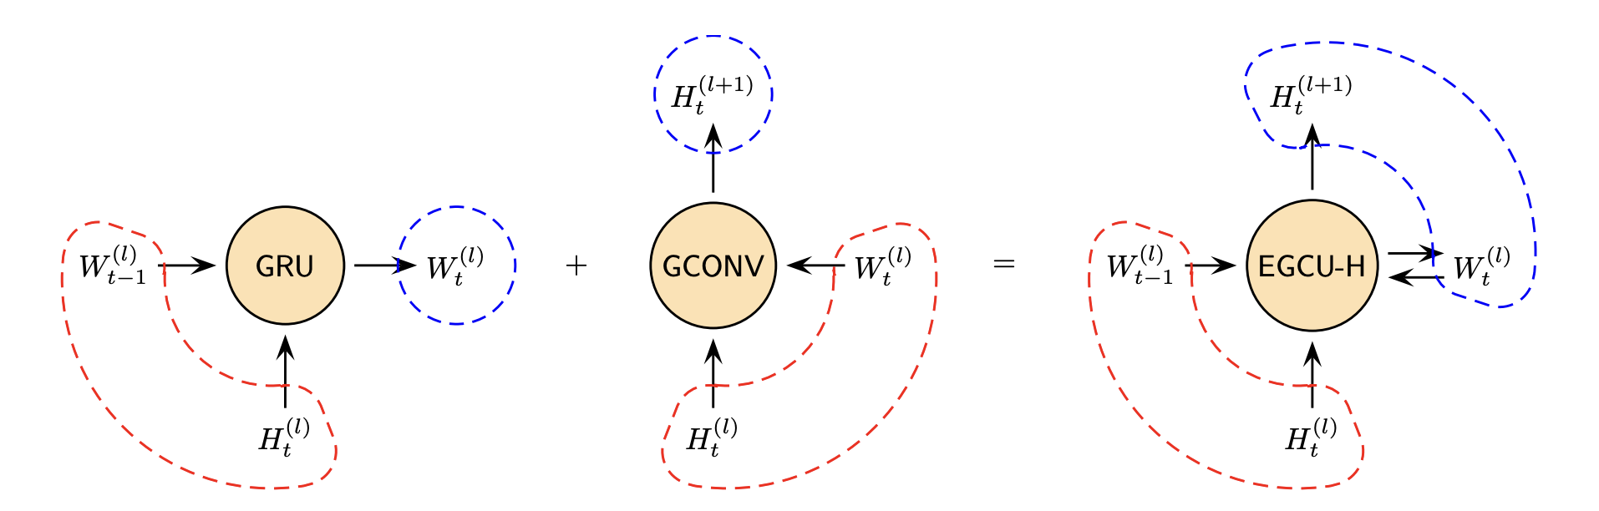
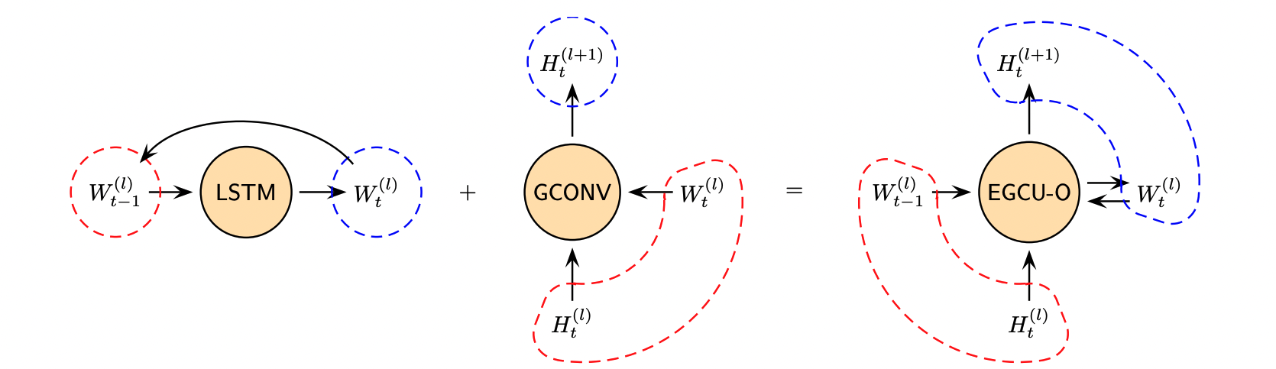
EGCN-O vs ECGN-H
ECGN-H uses a Gated Recurrent Unit (GRU)
GCN parameters are hidden states of the recurrent architecture that takes node embeddings as input
ECGN-O uses Long Short Term Memory (LSTM) cells
GCN parameters are the inputs and outputs of the recurrent architecture

Slide 11
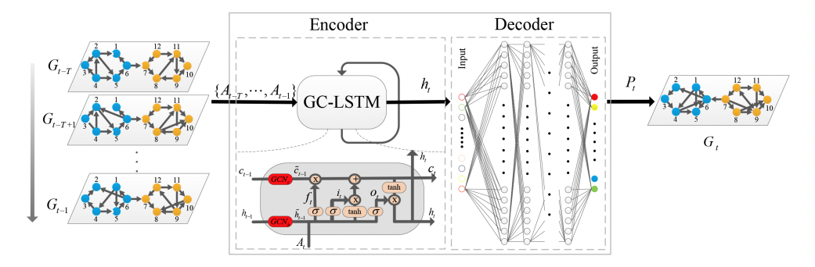
GC-LSTM Model
Consist of an Encoder-Decoder structure
Encoder utilizes both GCN and LSTM frameworks to capture spatial and temporal dependencies
Uses Chebyshev Polynomials to approximate graph convolutions
Decoder is a fully connected layer network that converts features back to its original space and output a predicted network
In this figure, it shows the overall framework of both the encoder and decoder model for GC-LSTM model where it uses two GCN’s embedded into the LSTM to learn both the spatial and temporal dependencies.

Slide 12
Model Comparison: Overview
Implementation
In python, utilizing Pytorch Geometric Temporal in model implementation and usage
Experiment
Evaluated under common data set
Predicting future traffic speed ahead by 15 / 30 / 60 minute
Comparison Metrics
Mean Absolute Error (MAE)
Mean Squared Error (MSE)
Root Mean Squared Error (RMSE)

Slide 13
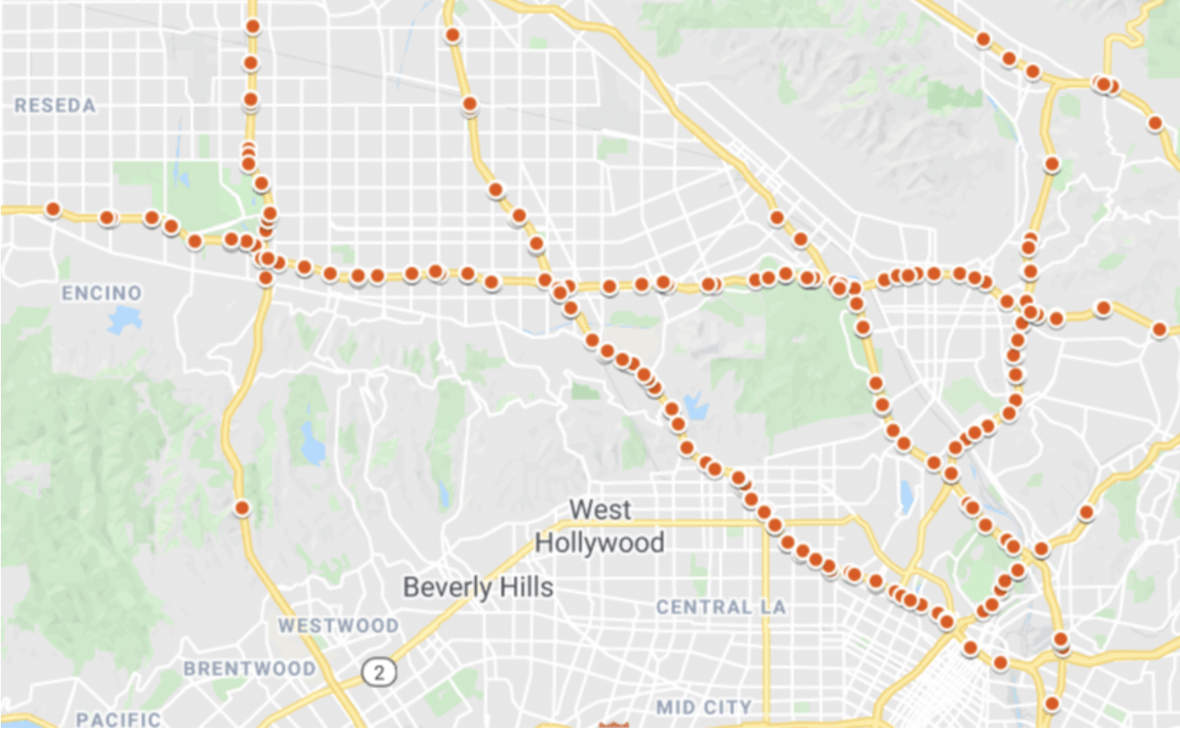
Model Comparison: Data Set
METR-LA Dataset
207 loop sensors in north Los Angeles measuring highway speed in 5 minute intervals
Taken between March to June 2012

Slide 14
Model Comparison: Training/Evaluating
34249 samples split into 80% train and 20% test data
TGNN Representation
207 sensors -> 207 nodes
distance between adjacent sensors -> directed weighted edges
speed and time -> 2 nodal features
5 minute intervals -> a single timestep
Speed values are normalized using Z-Score transformation (for pytorch models to work more appropriately)

Slide 15
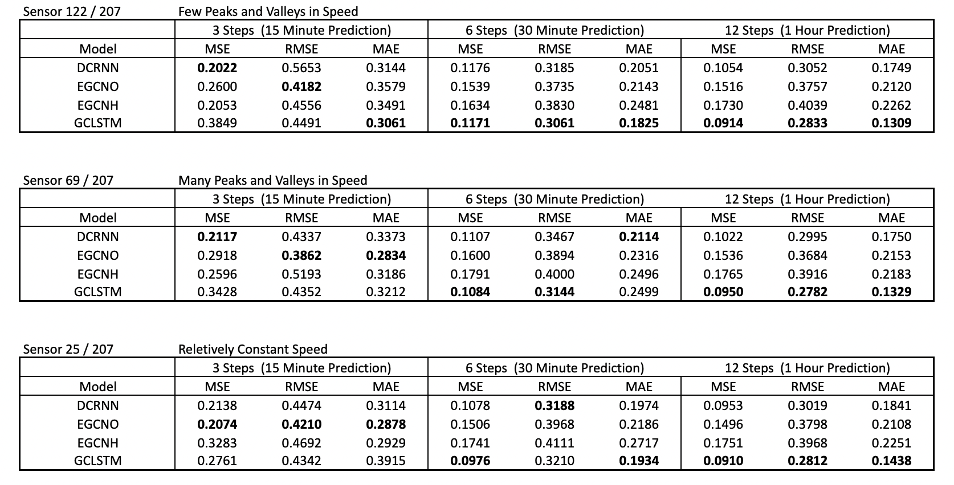
Model Comparison: Results

Slide 16
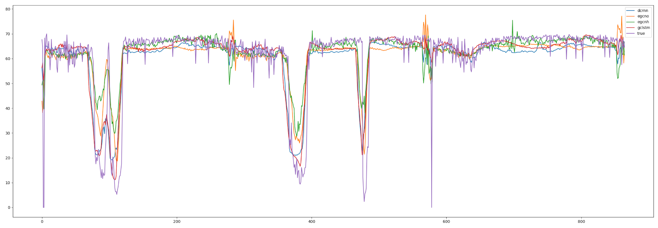
Predictions Visualization Sensor 122

Slide 17
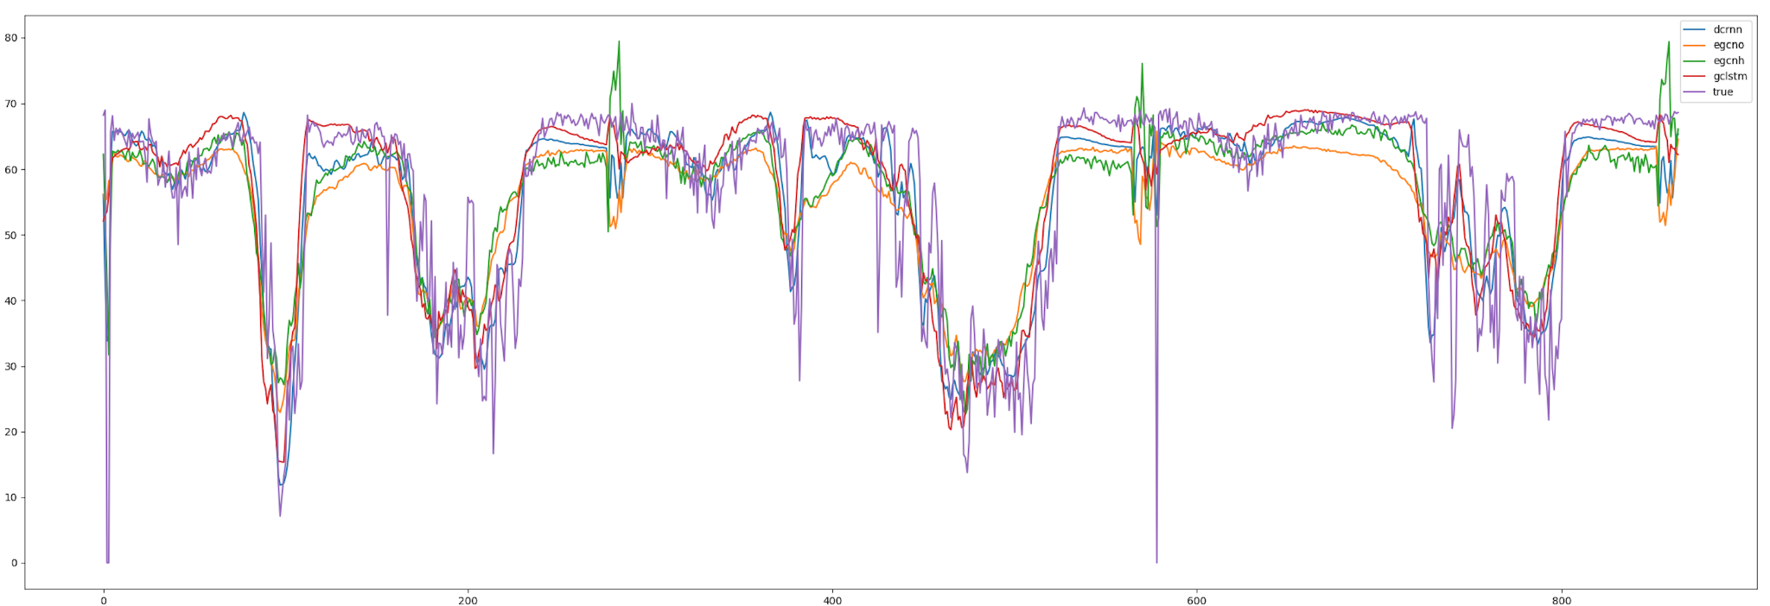
Predictions Visualization Sensor 69

Slide 18
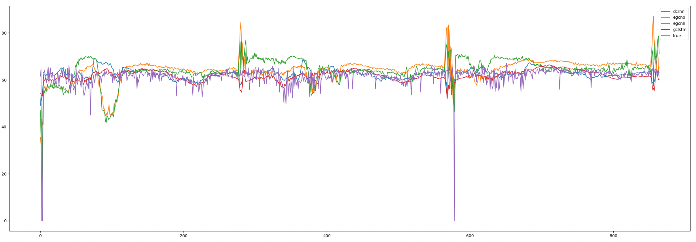
Predictions Visualization Sensor 25

Slide 19
Conclusions
EGCNO most consistent model for near future predictions
GCLSTM consistently the best for further predictions but occasionally the worst for near predictions
Both EGCN models are worse in predicting peak and valley trends and have random spikes when ground truth is relatively constant
DCRNN consistently second best performance across all timesteps and sensors, most reliable in terms of overall consistency
Overall, GCLSTM seems to be the most suitable for this task

Slide 20
Future Directions
Integration of outside factors including road accidents or weather conditions
Survey / comparison with the Attention based family models (here we use models with only LSTM and GRU temporal layers)
Survey / comparison of models over dynamic road network graph (here our graph only has a static number of nodes and edges)
Survey / comparison of models over suburban road networks

Slide 21
Thank you for listening!
Questions?

Slide 22
References
https://infrata.com/news
https://arxiv.org/pdf/1902.10191.pdf
https://arxiv.org/ftp/arxiv/papers/2104/2104.13096.pdf
https://arxiv.org/ftp/arxiv/papers/1802/1802.07007.pdf
https://sci-hub.se/https://ieeexplore.ieee.org/document/8845132
https://link.springer.com/content/pdf/10.1007/s10489-021-02518-9.pdf

